Slide 1

Supporting Academic and Social-Emotional Education of Students with X Y Chromosome Variations Amy Talboy, MD., Department of Human Genetics, Emory University Catherine Trapani, Ph.D., BCBA, Trapani Education Consultants, LLC
Addressing the needs of diverse learners for success

Slide 2

Agenda for Discussion
Understanding X Y Chromosome Variations
Academic Challenges and Strategies
Social-Emotional Development and Support
Collaborative Efforts and Resources

Slide 3
Understanding X Y Chromosome Variations

Slide 4
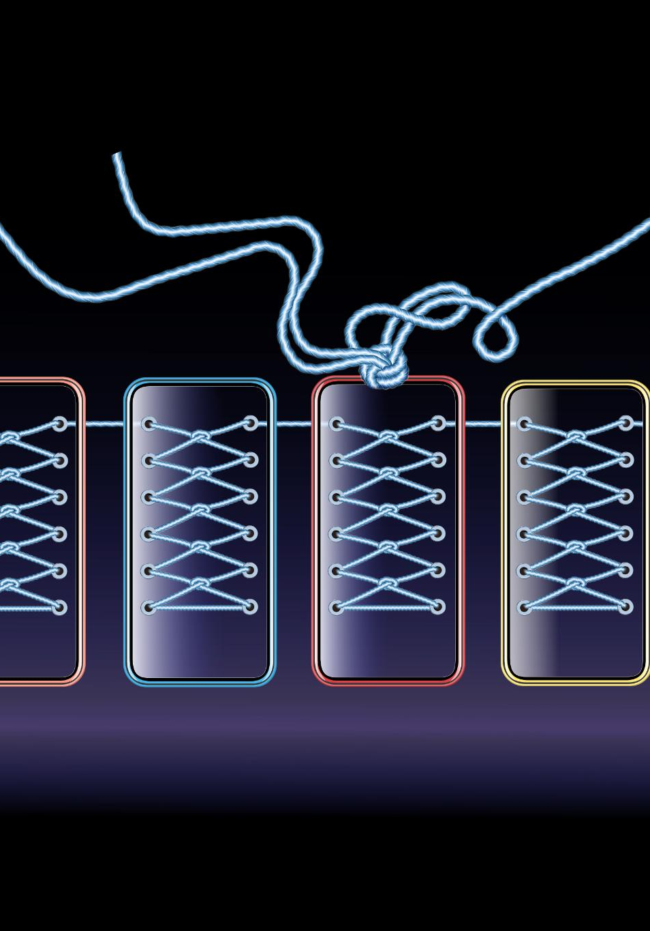
Prevalence and Diagnosis
Common Condition
X Y Chromosome Variations occur in approximately 1 in 500 live births, indicating their prevalence in the population.
Genetic Testing
Diagnosis of X Y Chromosome Variations often occurs through genetic testing, providing critical information for understanding individual needs.
Understanding Needs
Genetic testing helps identify potential challenges and special needs of affected students, guiding appropriate support and interventions.

Slide 5
Common Characteristics and Symptoms
Associated Medical Characteristics
Individuals may present with a variety of physical differences, which can vary widely among affected individuals.
Cognitive Challenges
Learning disabilities are common among individuals with X Y Chromosome Variations, impacting educational experiences.
Emotional and Social Impact
Social challenges can affect relationships and emotional well-being, making support systems important for quality of life.

Slide 6
Outcomes for Students with X Y Chromosome Variations
Unique Challenges
Students with SCA face unique challenges in cognitive, social, and physical development requiring specialized attention.
Early Intervention
Timely intervention and tailored educational strategies may significantly improve the outcomes for students with SCA.
Supportive Environments
Creating supportive environments enables better academic and social integration for students with SCA, enhancing their quality of life.

Slide 7
Academic Challenges and Strategies

Slide 8

Impact on Cognitive Development and Learning
Language Development
Students with X Y Chromosome Variations often face difficulties in language development, impacting their communication skills. Deficits in language and communication may impede acquisition of other basic skills.
Executive Functioning
Difficulties in executive functioning can hinder students' planning, organization, and task management abilities in learning and work environments.
Social Cognition
Challenges in social cognition may affect students' interactions and relationships with peers, teachers, and parents influencing their overall educational experience.

Slide 9

Educational Plans and IEPs
Importance of Individual Education Programs
IEPs are crucial for addressing the unique educational and social-emotional needs of THE student.
Tailored Learning Plans
Tailor the educational plan to focus on specific strengths and challenges, ensuring effective learning experiences for the student.
Collaboration and Support
Successful IEP implementation requires collaboration among educators, parents, and specialists.

Slide 10
Effective Teaching Methods and Accommodations
Differentiated Instruction
Differentiated instruction designs educational experiences to meet individual student needs, enhancing engagement and progress.
Regular Feedback
Providing regular feedback helps students to understand their progress and promotes a growth mindset toward future transitions.
Accommodations for Learning
“Time to learn,” extended time, and grounding lessons in real-life activities supports students in demonstrating and maintaining their knowledge and skills.

Slide 11

Key Websites
Information, Education Services and Guidelines:
Association for X and Y Chromosome Variations (AXYS) https://genetic.org/
Attention Deficit Hyperactivity Disorder Association (ADDA)
https://add.org/
Children and Adults with Attention-Deficit/Hyperactivity Disorder (CHADD)
CHADD - Improving the lives of people affected by ADHD
Council for Exceptional Children (CEC)
Council for Exceptional Children | The premier association for special education professionals
International Dyslexia Association
International Dyslexia Association - …until everyone can read!
Learning Disabilities Association of America (LDA)
Learning Disabilities Association of America – Support. Educate. Advocate.

Slide 12
Key Websites
Information, Education Services and Guidelines for College Students:
Affordable Colleges Online - Guide To Disability Rights In College: This guide provides an overview of the ADA and other relevant laws protecting the rights of college students with disabilities.
College Atlas - The Ultimate Guide for College Students With Disabilities: This website lists resources and support programs available to college students with disabilities.
Learning Disabilities Association of America (LDAA): The LDAA offers information and resources for college students with learning disabilities, including their rights and responsibilities.

Slide 13
Social-Emotional Development and Support

Slide 14

Challenges in Social and Emotional Skills
Understanding Social Cues
Students may struggle to interpret social cues, leading to misunderstandings and inappropriate behavior
Impact of Anxiety and Depression
Anxiety and depression may hinder students' engagement with their peers and social activities.
Engagement with Peers
The challenges of social interactions can affect overall social skills, peer engagement, and formation of friendships leading to reduced social interaction or isolation.

Slide 15
Developing Social Skills and Peer Relationships
Importance of Social Skills
Developing social skills is essential for students to effectively interact and build acquaintances and friendships.
Navigating Social Situations
Targeted training helps students learn how to navigate various social situations confidently and appropriately.
Building Meaningful Relationships
Exposure to real social interactions aids students in forming and nurturing meaningful relationships, vital for their emotional health.

Slide 16
Key Websites
Information, Social Emotional Learning
Association for X and Y Chromosome Variations (AXYS) https://genetic.org/
Attention Deficit Hyperactivity Disorder Association (ADDA) https://add.org/
Children and Adults with Attention-Deficit/Hyperactivity Disorder (CHADD) CHADD - Improving the lives of people affected by ADHD
National Alliance on Mental Illness (NAMI) National Alliance on Mental Illness (NAMI) | Mental Health Support, Education & Advocacy

Slide 17

Counseling,and Psychological Support
Emotional Support
Counseling services offer crucial emotional support to students facing various challenges in their lives.
Coping Strategies
Counselors help students develop effective coping strategies to manage stress and emotional difficulties.
Accessibility of Services
Ensuring access to counseling services is essential for student well-being and mental health support.

Slide 18
Collaborative Efforts and Resources

Slide 19

Involvement of Parents and Caregivers
Essential Educational Partners
Parents and caregivers play a crucial role in the educational journey of students by providing support and encouragement.
Enhancing Student Support
The involvement of parents and caregivers can significantly enhance the resources and support available to students in their education.

Slide 20

Accessing Medical and Community Resources
Importance of Connection
Connecting families with the right resources can enhance a students’ support system promoting their well-being.
Supportive Therapy Services
Therapy services are essential in providing emotional and mental health support, helping students navigate challenges effectively.
Advocacy and Educational Materials
Advocacy groups and educational materials empower families, ensuring they have the tools necessary to support their children.

Slide 21
Impact of dismantling the Federal Department of Education on students in need of accommodations

Slide 22

Effects on Vulnerable Students
Does not eliminate any of the education, disability, or civil rights for students with disabilities
Only Congress has the right to move IDEA programs to Health and Human Services
The Federal gov’t through Congress allocates the amount of money schools receive (6-13 percent)
The interpretation and administration of rights through the federal laws varies markedly from county to county and state to state these discrepancies may increase

Slide 23
Effects on Vulnerable Students
Reduced Funding and Resources
Vulnerable students may lose crucial funding and resources that support their educational needs and services.
Weakened Oversight for Special Programs
Oversight for special education and low-income student programs could weaken, leading to inconsistencies and gaps in support.
Threatened Educational Rights
Consistent educational protections may be threatened, putting the most vulnerable students at greater risk of inequality.

Slide 24
Now is the time for parents of students across all diagnostic categories to form unified collaborative partnerships (with each other, and all service providers) to advocate for the academic, social, and transition needs of their “collective” children in all public and private schools across the nation.

Slide 25
What to do?
Multifaceted Support Approach
A comprehensive approach is necessary to address students’ academic, and social-emotional needs.
Collaboration Among Stakeholders
Collaboration among families, educators, and community is essential to a supportive learning environment.
Empowering Students
An appropriate environment may empower students to achieve success in their academic, social, and life journeys.

Slide 26
Special Education Law Reference Yell, M.L. (2018). The law and special education. 5th edition. Pearson. ISBN-10 0135175364

Slide 27
Sources

Slide 28
AXYS Clinic and Research Consortium, (2020) Educational Guidelines, IEPs, and School Services for children with X Y Chromosome Variations Boothe, D., Cover, G. (2024) Transition to Adulthood for Individuals with X and Y Variations. AXYS Clinic and Research Consortium Ratcliffe, S. (1999). Long term outcome in children of sex chromosome abnormalities. Archives of Disabled Child (80): 192-195 Simpson, N.H., Addis, L. Brandler, W. M., Slonims, V., Clark, A., Watson, J., Scerri, T.S.; Hennessy, E.R., Bolton, P.F., Conti-Ramsden, G., Fairfax, B.P., Knight, J.C., Stein, J., Talcott, J.B., O’Hare, A., Baird, G., Paracchini, S., Fisher, S.E., Newberry, D.F., and Consortium, S. (2014). Increased prevalence of sex chromosome aneuploidies in specific language impairment and dyslexia. Developmental Medicine and Child Neurology, 56: 346-353. Thompson, T., Stinnett, N., Tartaglia, N., Davis, S., and Janusz, J. (2022). I wish the school had a better understanding of the diagnosis: parent perspectives on educational needs of students with sex chromosome aneuploidies. Journal of Resources in Special Education Needs April 22 (2): 175-187 Thompson, T., Davis, S., Takamatsu, S., Howell, S., and Tartaglia, N. (2022). Exploring academic and character strengths in students with sex chromosome aneuploidies. Journal of Positive School Psychology, Vol 6, No. 1, 12-24. Thompson, T., Davis, S., Janusz, J., Frith, E., Pyle, L., Howell, S., Boada, R., Wison, R., and Tartaglia, N. (2022). Supporting students with sex chromosome aneuploidies in education settings: Results of a nationwide survey. Journal of School Psychology August;93:28-40.

Slide 29
Resources

Slide 30
Key Websites
Information, Education Services and Guidelines:
Association for X and Y Chromosome Variations (AXYS)
https://genetic.org/
Attention Deficit Hyperactivity Disorder Association (ADDA) https://add.org
Children and Adults with Attention-Deficit/Hyperactivity Disorder (CHADD) CHADD - Improving the lives of people affected by ADHD

Slide 31
Key Websites
Information, Education Services and Guidelines
Council for Exceptional Children (CEC)
Council for Exceptional Children | The premier association for special education professionals
International Dyslexia Association
International Dyslexia Association - …until everyone can read!
Learning Disabilities Association of America (LDA)
Learning Disabilities Association of America – Support. Educate. Advocate.

Slide 32
Key Websites
Resources for College Students:
Affordable Colleges Online - Guide To Disability Rights In College: This guide provides an overview of the ADA and other relevant laws protecting the rights of college students with disabilities.
College Atlas - The Ultimate Guide for College Students With Disabilities: This website lists resources and support programs available to college students with disabilities.
Learning Disabilities Association of America (LDAA): The LDAA offers information and resources for college students with learning disabilities, including their rights and responsibilities.

Slide 33
Key Websites
Information, Education Services and Guidelines
National Alliance on Mental Illness (NAMI)National Alliance on Mental Illness (NAMI) | Mental Health Support, Education & Advocacy

Slide 34
Key Websites
These websites provide a starting point for understanding the legal rights of students with disabilities. Remember that each situation is unique, and you may need to consult with a legal professional or advocacy organization to get specific advice tailored to your circumstances.

Slide 35
Key Websites
Legal rights of students with disabilities
Government Websites:
ADA.gov: The Americans with Disabilities Act:
This is the official website for the Americans with Disabilities Act (ADA) a federal law protecting individuals with disabilities from discrimination in various settings, including education.
U.S. Department of Education:
Individuals with Disabilities Education Act (IDEA): This website provides information and resources about the IDEA, which ensures that children with disabilities receive a free appropriate public education (FAPE).

Slide 36
Key Websites
Legal Rights cont.
Section 504 of the Rehabilitation Act: This section prohibits discrimination based on disability in programs receiving federal funding, including educational institutions.
Disability Discrimination: This page offers details on disability discrimination, including information on filing a complaint with the Office for Civil Rights.

Slide 37
Key Websites
Advocacy and Support Organizations:
Wrightslaw Special Education Law and Advocacy https://www.wrightslaw.com
This website provides up-to-date information on special education law and advocacy for parents, advocates, teachers, and attorneys.
National Disability Rights Network (NDRN):
NDRN works to protect the rights of individuals with disabilities by advocating for their basic rights and ensuring accountability in various areas, including education.
Disability Rights Education and Defense Fund (DREDF) https://dredf.org
DREDF is a national civil rights law and policy center focused on advancing the rights of people with disabilities through legal advocacy, training, and education.

Slide 38
Key Websites
Advocacy and Support Organizations cont.:
Parent to Parent of Georgia:
This organization provides resources and support to parents of children with disabilities, including information on their rights under IDEA and how to resolve disputes with schools.
GeorgiaLegalAid.org
Offers information and resources regarding special education rights and procedures, such as participating in IEP meetings and seeking legal help.

Slide 39
Computer-Assisted-Instruction
Reading
Lexia
https://www.lexialearning.com
Executive Function
SMARTS
https://smarts-ef.org
Social Skills
Social Express
https.lexlogin.com (best when combined with group collaborative activities reflecting interests and talents e.g., drama, art, cartooning, music, cooking, horticulture, Lego, and sports lessons programs)

