Slide 1

Wired Differently: Navigating Anxiety and ADHD in Adolescents and Young Adults with X & Y Chromosome Variations
Joanna Dreyer, PharmD, BCPPS
Clinical Pharmacist, Developmental & Behavioral Pediatrics
Kate Deer, PsyD
Assistant Professor, University of Colorado School of Medicine

Slide 2
Objectives
Understand prevalence of ADHD and anxiety in different X and Y chromosomal variations
Explore symptoms and real-life presentations of ADHD and anxiety for those with X and Y chromosomal variations
Review evidence-based behavioral and medication treatment interventions

Slide 3
Disclosures
None of the authors have any financial disclosures or conflicts of interest
We are not endorsing any specific medication, brand, or company
All medication and treatment should be discussed with your child's provider
We cannot make specific recommendations without evaluating an individual patient
We will be discussing off-label use of medications

Slide 4
Prevalence
Are anxiety and ADHD more common in teens and young adults with XY chromosome variations?
Yes
Notes:
Kuiper et al (2021):
On average, the following met full diagnostic criteria for ADHD:
43% of 47,XXY (with a range of 24%–63%)
49% of 47,XXX (with a range of 25%–49%)
36% of 47,XYY (with a range of 11%–52%)
ADHD symptoms tend to present earlier in XY variations
Inattentive symptoms tend to become more pronounced with increasing age in XY variations
Inattentive symptoms are most common in 47,XXY and 47,XXX
47,XYY boys are likely to present hyperactive/impulsive symptoms as well (Tartaglia et al., 2012)

Slide 5
X&Y Variations
Differences in Brain Function
Behavioral / Emotional
Short Attention Span
Distractibility
Hyperactivity
Impulsivity
Anxiety
Depression
Irritability / Aggression
Meltdowns / Tantrums
Obsessive-Compulsive Behaviors
Repetitive / Stereotypic Behaviors
Cognitive / Learning
Developmental Delay
Learning Disability (LD)
Intellectual Disability (ID)
Social Development
Social immaturity
Autism
ADHD
Notes:
Ciara

Slide 6
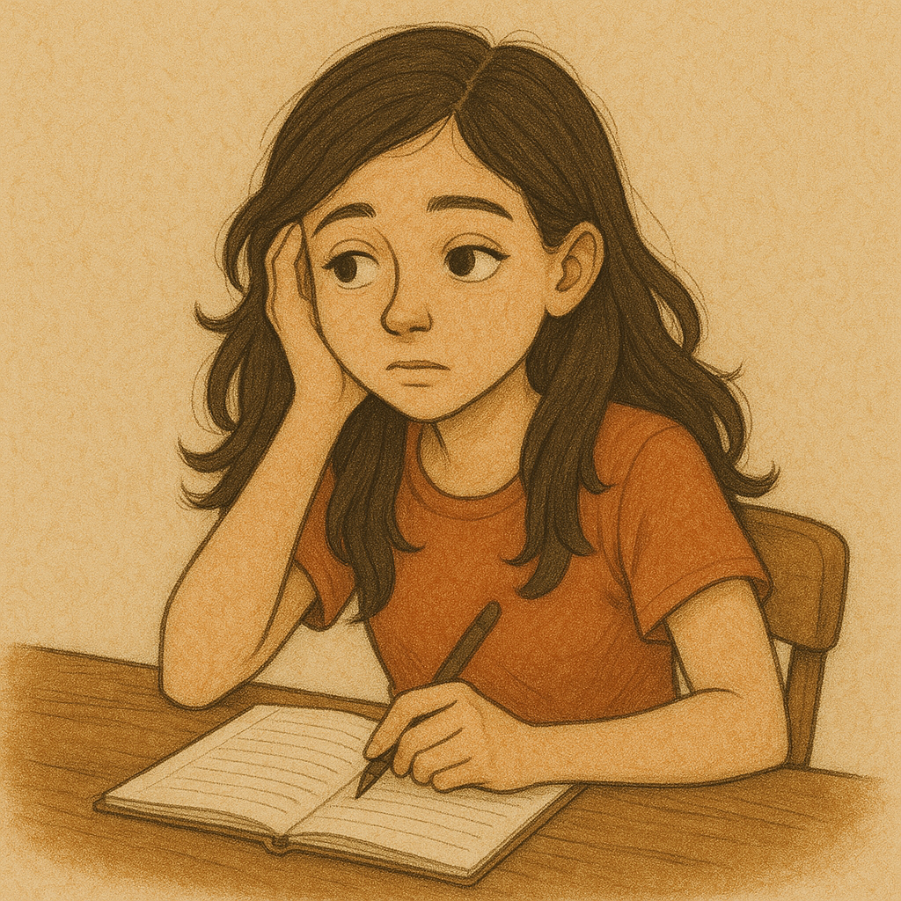

ADHD, Combined Type
ADHD, Predominantly Inattentive Type
ADHD, Predominantly Hyperactive/Impulsive Type
Notes:
ADHD is a persistent pattern of inattention and/or hyperactivity-impulsivity that interferes with functioning and development
An individual needs 6+ symptoms in either or both categories to qualify for a diagnosis. Several symptoms must be present in 2+ settings. And, not exclusively during a psychotic disorder or better explained by another disorder.

Slide 7
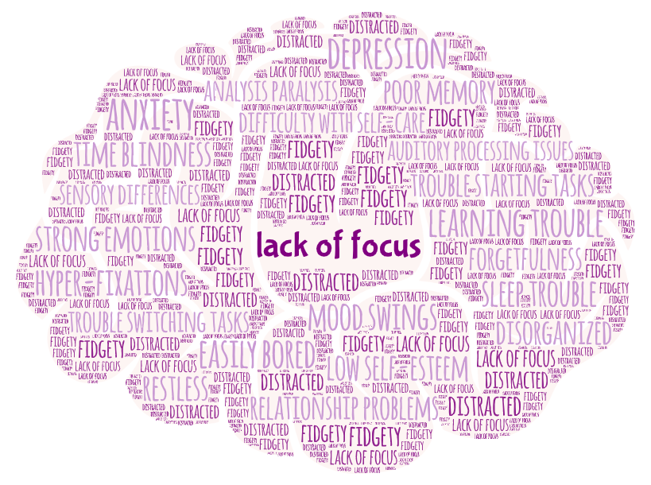
ADHD is more than Inattention...
Anxiety
Analysis paralysis
Depression
Difficulty with adaptive tasks
Easily bored
Mood swings
Poor memory
Low self-esteem
Sensory differences
Sleep trouble
Time blindness
Creativity
Persistence
Curiosity
Resourcefulness
Sense of humor
Resilience
Imagination
Innovative
Notes:
Additional areas of impact:
Analysis paralysis
Auditory processing issues
Difficulty with self-care
Disorganized
Forgetful
Poor memory
Trouble starting, finishing, and switching between tasks

Slide 8
ADHD Is Complex in X&Y
Risk for LD
Trouble getting the right academic supports
Sensory
Learning
Executive Functions
Social-Emotional
Mood
Language
Medical
Receptive > Expressive
Trouble processing lots of talking
ADHD
Immaturity
Disconnection
Trouble identifying & expressing feelings
Notes:
Ciara
ADHD/Anxiety flower
I don't need to tell you guys that with XY and variations have challenges in some or all of these areas
What I do want to highlight is that these symptoms not only can cause challenges in an of themselves, but also can contribute to anxiety and ADHD symptoms
For example – sensory differences with loud noises or environments may result in heightened anxiety in public places
Learning challenges in school may result in attention difficulties and low self-esteem
Medical considerations – if a child has a lot of GI issues requiring appointments, procedures, etc this may result in heightened medical anxiety

Slide 9
Special Considerations for Teens & Young Adults
Expectation for greater independence
Higher stakes consequences
Symptoms shift
Increased demands
Not Aligned with Developmental Level or Support Needs
Notes:
ADHD in teens and young adults isn't the same as ADHD in younger kids. There are additional things we need to consider.
Potential for higher stakes consequences examples:
Blurting out a rude comment in third grade is very different than blurting out a rude comment in high school or at a work meeting
Impulsively kicking a ball on top of a roof is very different than impulsively buying an expensive item
Substance use may occur as a form of self-medication or attempt to fit in
As children get older, the vulnerability to co-occurring mental health conditions increases

Slide 10

Anxiety
Physiological: Arousal
Behavioral: Withdrawal, seeking reassurance
Cognitive: Distortions, negative self-talk, rumination
Notes:
If you’re breathing, you’ve experienced anxiety. It's a human condition. In many situations, anxiety is adaptive and helpful. When anxiety is too intense (excessive), too frequent (persistent), and/or gets in the way of daily interactions (interfering), it becomes something we want to pay more attention to and intervene.

Slide 11


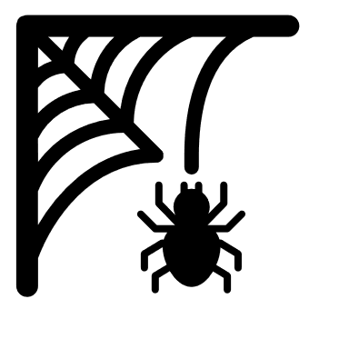

Anxiety Disorders
Generalized Anxiety Disorder
Social Anxiety Disorder
Specific Phobia
Other Specified Anxiety Disorder
Notes:
These are some of the more common anxiety disorders we see and for which we'd want to assess. In all cases, functional impact must be noted, and symptoms must not be better explained by another diagnosis.
Generalized Anxiety Disorder is characterized by excessive anxiety and worry, occuring more days than not for 6 months, about a number of events or activities. It's a pervasive sense of worry that the person finds difficult to control. The anxiety is associated with 3+ of the following, with at least some symptoms being present more days than not for the past 6 months: restlessness/being keyed up or on edge, easily fatigued, difficulty concentrating, irritability, muscle tension, sleep trouble.
Specific Phobia refers to marked anxiety about a specific object or situation, which almost always provokes immediate fear. The object or situation is endured with intense fear or avoided. It is out of proportion to the actual threat or danger posed by the object or situation. The anxiety is persistent (6+ months).
Social Anxiety Disorder is characterized by marked fear or anxiety about one or more social situations where the person is exposed to possible scrutiny by others. The person fears that they will act in a way or show anxiety symptoms that will be negatively evaluated. Social situations almost always provoke anxiety and are endured with intense anxiety or avoided. Fear is out of proportion to the actual threat and is persistent (6+ months).
Other Specified Anxiety Disorder is a diagnosis I often give and see in youth with XY variations. This applies to anxiety presentation in which there are anxiety symptoms that are evident but do not meet full criteria for any of the other anxiety disorders. I often find there are a mix of anxious features that don't "fit" neatly into one category.

Slide 12

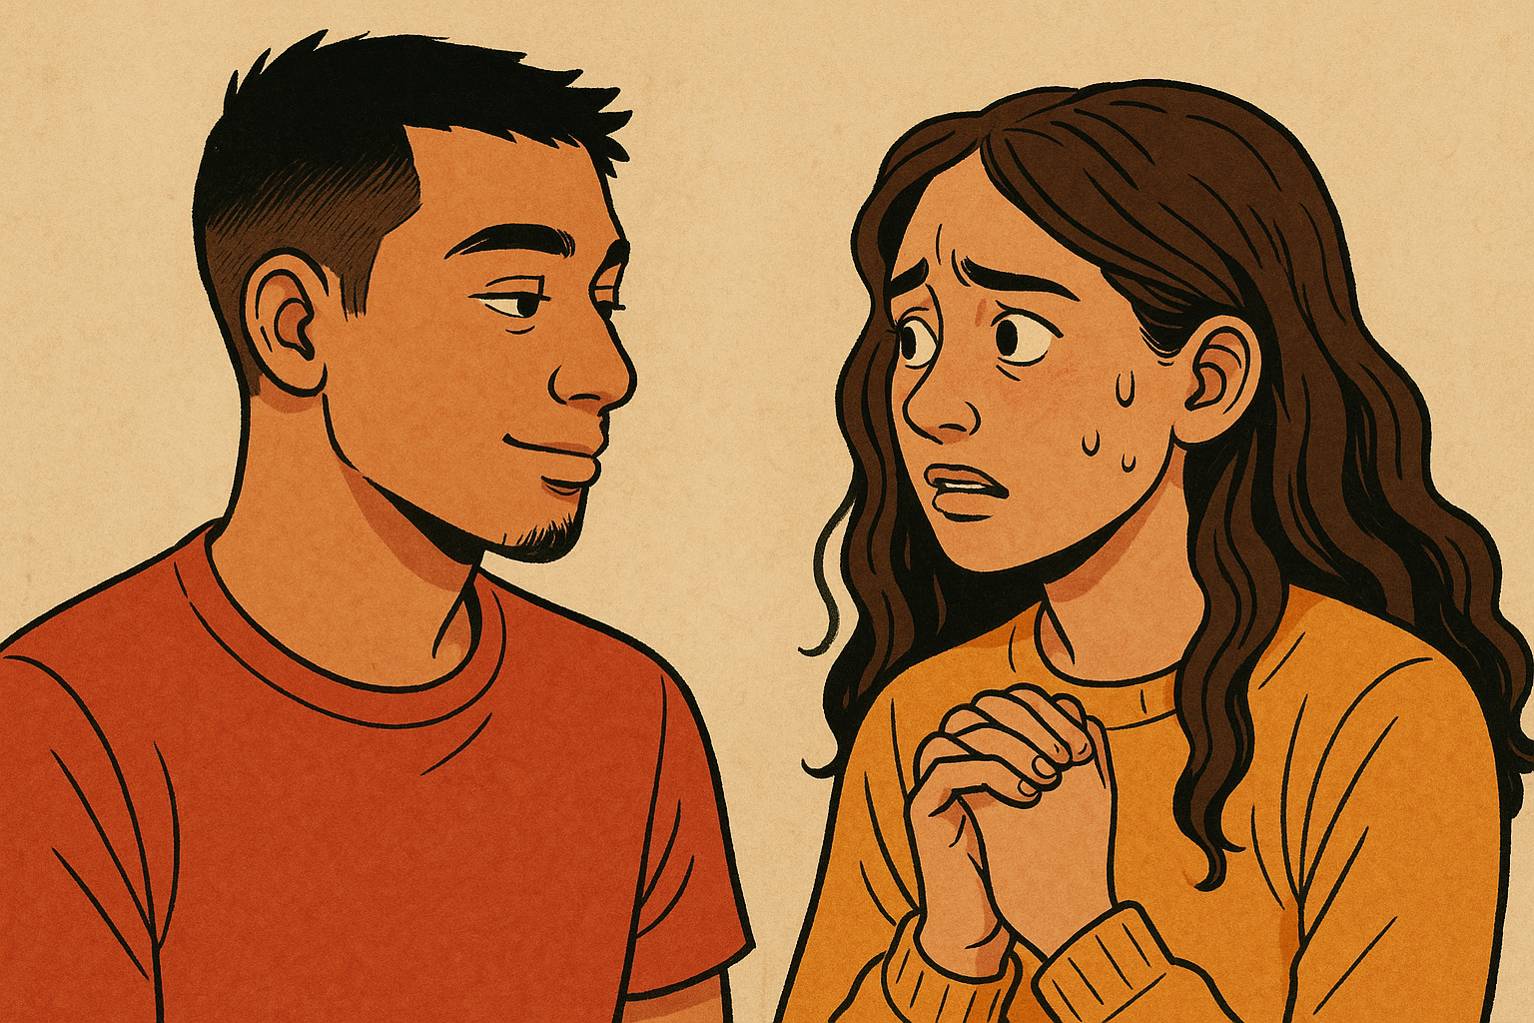
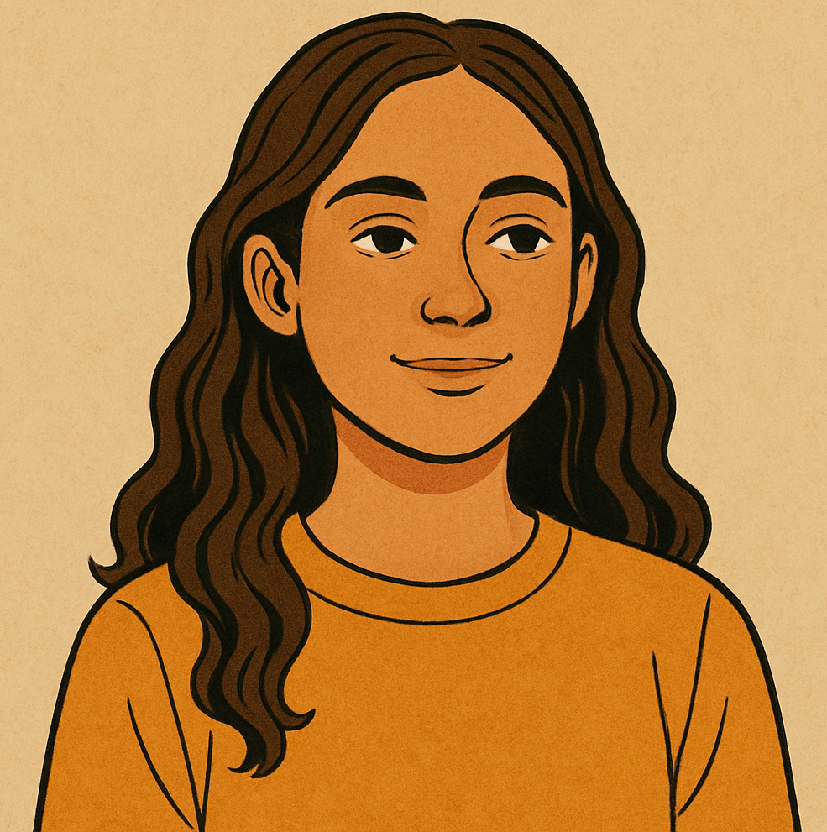
Me:
What could go wrong?
Anxiety:
I'm so glad you asked...
Notes:
Edgy or irritable behavior- big reactions to seemingly small problems, particularly with language differences that may impact ability to express worries

Slide 13
Anxiety Is Complex in X&Y
Sensory
Executive Functions
Learning
Social-Emotional
Language
Mood
Medical
Sleep & eating changes
Physical complaints
Trouble focusing
Rigidity
Irritability
Mood swings
Meltdowns
Anxiety
Clingy
Lots of questioning
Avoidance
More screen time
Notes:
Ciara
ADHD/Anxiety flower
I don't need to tell you guys that with XY and variations have challenges in some or all of these areas
What I do want to highlight is that these symptoms not only can cause challenges in an of themselves, but also can contribute to anxiety and ADHD symptoms
For example – sensory differences with loud noises or environments may result in heightened anxiety in public places
Learning challenges in school may result in attention difficulties and low self-esteem
Medical considerations – if a child has a lot of GI issues requiring appointments, procedures, etc this may result in heightened medical anxiety

Slide 14
Assessment & Evaluation
Best practice = multi-disciplinary evaluation including (neuro)psychological testing
Notes:
When anxiety is too intense (excessive), too frequent (persistent), and/or gets in the way of daily interactions (interfering), it becomes something we want to pay more attention to. Similarly, when trouble with attention or regulating behavioral activity is getting in the way of success at home, school, or in the community, evaluation is warranted.
Given the increased vulnerability to ADHD and anxiety in X & Y chromosome variations, early screening and close monitoring is key to early detection and treatment.
Why full multi-disciplinary evaluation- Because these things can be easy to miss and, thus, under-diagnosed. The needs of youth with X & Y variations are complex and multi-faceted. Beyond assessing for symptoms of anxiety and/or ADHD, understanding a child's language, cognitive, executive functioning, and sensory processing skills can help inform diagnosis and a treatment plan. You can think of diagnosis as a method of communication and a beacon that points the way to evidence-based treatment.

Slide 15
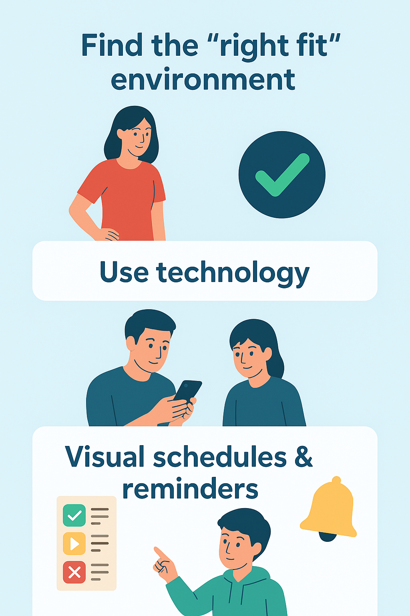
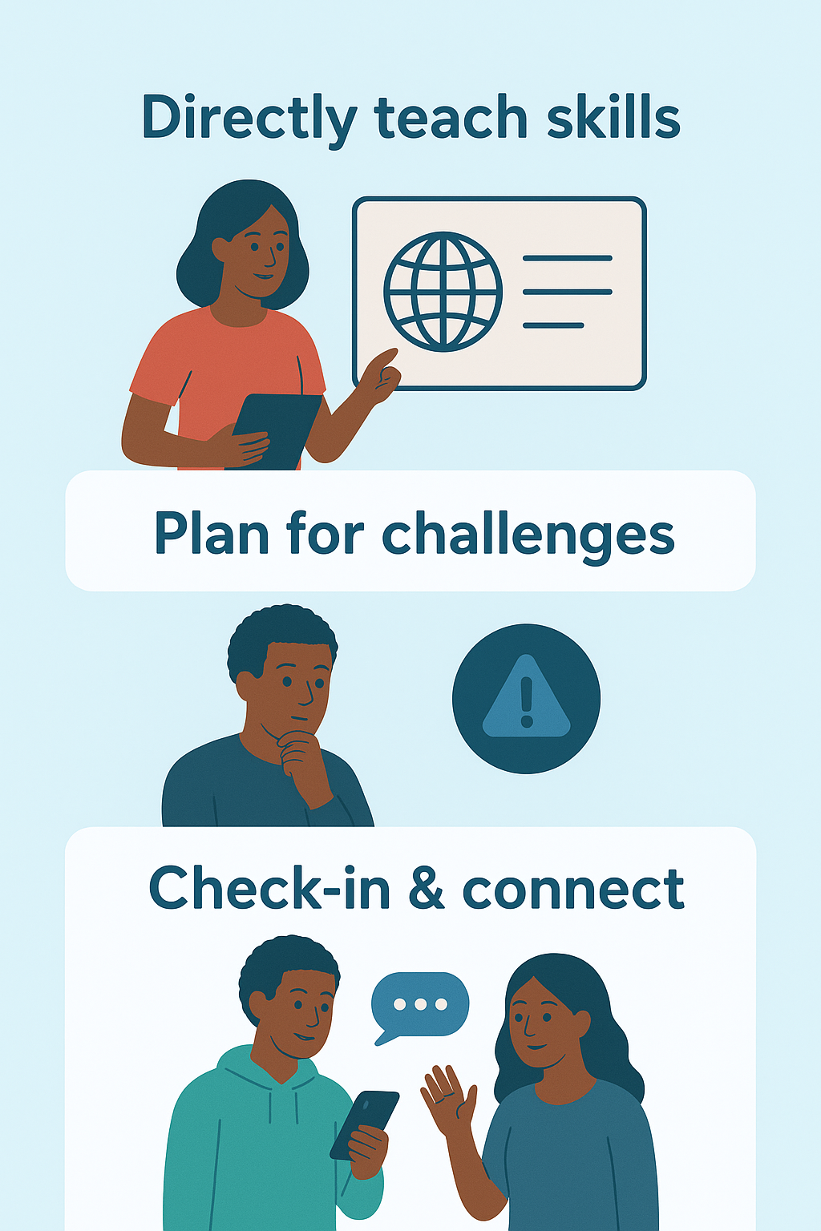
Tips
&
Tricks
Notes:
Role-playing
Experiential learning
Video modeling
Plain language
Help connecting skills across settings & situations
Be mindful of negative feedback, both from others and in the form of negative self-talk
Teach self-awareness so youth are increasingly able to course-correct when needed and advocate for themselves
This is a really exciting- and scary- part of life. Embrace and celebrate it!

Slide 16
Formal Interventions
Prosocial activities
Yoga
Speech/language therapy
Occupational therapy
School accommodations
Vocational training
Cognitive-Behavior Therapy (CBT)
Dialectical Behavior Therapy (DBT)
Desensitization or exposure-based therapies
Transition Supports
Notes:
When: Daily interference/impact, needing to do lots of accommodating to get through the day
For kids with lower cognitive skills (IQ less than 70), more focus on behavioral components
Increased visuals, parent support, routine-based learning, repetition, and experiential learning (e.g., role plays, intentional exposures in the clinic or community)
Transitional supports
AXYS-Consensus-Document-Transition-to-Adulthood-for-Individuals-with-X-and-Y-Variations.pdf
Advocacy- Help kids advocate for themselves, and recognize the need to continue to do so as a caregiver

Slide 17
Key Cognitive-Behavioral Principles & Adaptations
Plain language
Directly teach cognitive & somatic regulation skills
Do the hard things a little at a time (exposure)
Repetition, practice, & generalization
Caregiver involvement, with proper consent
Emphasize & build on strengths

Slide 18
Medications
One piece of overall treatment plan!
May be considered after or in addition to behavioral interventions and other strategies
Consider medications (continue behavior/other strategies!)
Not improving with behavior interventions/ other strategies
Symptoms are moderate-severe

Slide 19

Dr. Ts 5 Reasons to Start Medications
Safety
  Impulsivity leads to unsafe behaviors (e.g. crossing the street without looking)
Academics/work
  Short attention span impact ability to learn or complete tasks at work
Family life
  Distractibility or worry while getting ready to leave the house causes family stress
Social life
  Social anxiety leads to avoiding social activities
Self-esteem
  Expresses distress saying things like "Why are things so much harder for me?"
Notes:
Significantly impacting or causing impairment

Slide 20
Timing of Starting Medications
Symptoms Present
Symptoms cause mild to moderate impairment/problems
Symptoms cause moderate to severe impairment/problems
Crisis
Academic failure
Severe safety concersn
Hopitalizations

Slide 21
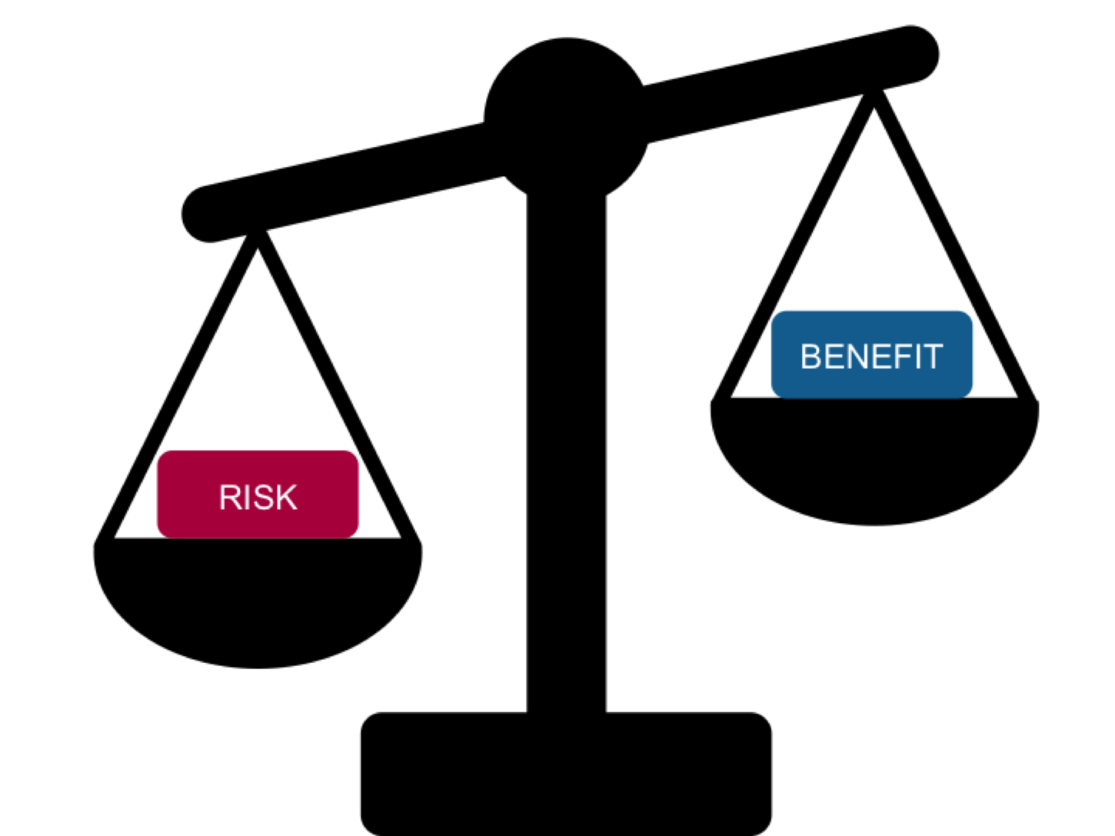
Weighing Risks and Benefits

Slide 22


Behaviors, relationships, daily functioning may improve Behavior interventions may be more effective Long-term academic and social development Feeling confident you are pursuing all options that may be helpful | Side effects Medications may not work Cost Medication monitoring Not learning skills to manage without medications Labs and other monitoring may be required
No risk of side effects No cost May be able to find other behavioral strategies that help | Inattention may make school or work difficult Anxiety may not allow them to fully participate in community activities Behaviors may be unsafe for themselves or others Behaviors may get worse
Taking Medications
Not Taking Medications

Slide 23

Target Symptoms
Identify the core symptom underlying challenging behavior = Target Symptom
Knowing the target symptom, helps identify what medication to start
There may be several symptoms, start with the target symptom(s) causing the most difficulty

Slide 24

Starting Medications
It is best to start medications one at a time
Start low and go slow!
Choosing a medications
  Chance for efficacy
  ​Risk for side effects
  Drug-drug interactions
  Other symptoms
Ask questions!

Slide 25
Questions to Ask Your Doctor
Options
Effectiveness
How to contact your doctor
What options have higher chance of efficacy
What symptoms will this medication help/not help
When should I expect this medication to start working
Side Effects
What are some common/serious side effects
What do I do if side effects occur
Are there any drug interactions with current medications or OTC/supplement medications
How to take the medication
Can this medication be crushed
Does this medication need to be taken with food or on an empty stomach
Should this medication be taken at a certain time of day
What is the best way to contact you
Is there a way to reach you or another provider on weekends
What options have less risk of side effects

Slide 26
Target Symptom = Hyperactivity, Impulsivity, Inattention
Stimulants
Methylphenidate-Based
Amphetamine-Based
Non-stimulants
Alpha-2 Agonists
Norepinephrine Reuptake Inhibitors
Ritalin
Concerta
Focalin
Clonidine
(Catapress, Kapvay)
Guanfacine
(Tenex, Intuniv)
Atoxetine
(Strattera) ​
Viloxazine
(Qelbree)
Adderall
Vyvanse

Slide 27


Stimulants (Amphetamines, Methylphenidates)
How they work
Increase activity of neurotransmitters in the brain, particularly dopamine and norepinephrine
Increased focus, attention, learning, motivation
Benefits
Safe and effective
Can help with fatigue
Work quickly
Can take breaks
Risks/Drawbacks
Appetite suppression
Increased blood pressure
Irritability
"Flat" affect
Rebound effect
Sleep disruptions
  Because medication is still active or rebound?
Caution with seizures and cardiac history

Slide 28
Alpha-2 Agonists (Clonidine, Guanfacine)
How they work
Stimulation of alpha-2 receptors
Decreased norepinephrine in body
Benefits
Safe and effective
Helpful for hyperactivity/impulsivity
Also used for anxiety, behavior outbursts, aggressive behaviors, sleep
Risks/Drawbacks
Drowsiness
Dry mouth, constipation
Risk for rebound hypertension with abruptly stopping

Slide 29
Norepinephrine Reuptake Inhibitors (Atomoxetine, Viloxazine)
How they work
Increase activity of norepinephrine in the brain
Benefits
May also help with anxiety
Risks/Drawbacks
Take some time to start working (especially atomoxetine)
Should be swallowed whole
Drug interactions (viloxazine and melatonin should not be taken together)
Can increase blood pressure

Slide 30
Target Symptom = Anxiety
SSRI
SNRI
Others
Sertraline
(Zoloft)
Escitalopram
(Lexapro)
Citalopram
(Celexa)
Fluoxetine
(Prozac)
Others
Duloxetine
(Cymbalta)
Venlafaxine
(Effexor)
Desvenlafaxine
(Pristiq)
Propranolol
Hydroxyzine
Alpha-2 Agonists
Bupropion
(Wellbutrin)
Buspirone
(Buspar)
Mirtazapine
(Remeron)
​
X2
OR

Slide 31
SSRIs (Sertraline, Escitalopram, Citalopram)
How they work
Increase serotonin levels in the brain
Benefits
  Well tolerated
  Safe and effective
  Less behaviors that stem from anxiety
    Picking, nail biting, behavior outbursts
  Fewer perseverations/worries
  Less tearfulness/emotional lability
  Able to transition better
  Can help with fixations and OCD symptoms
  Can help overall mood and irritability
Risks/Drawbacks
  GI side effects
  Can cause activation symptoms (irritability, agitation, insomnia)
  Drug interactions with fluoxetine, fluvoxamine

Slide 32
SNRIs (Venlafaxine, Desvenlafaxine, Duloxetine)
How they work
Increase serotonin and norepinephrine in the brain
Benefits
  Same as SSRIs
  May be helpful for ADHD (especially venlafaxine)
Risks/Drawbacks
Can increase blood pressure
Avoid venlafaxine in seizure disorder
Drug interactions with duloxetine

Slide 33
Others
Propranolol
Benefits
Can be used scheduled or as needed for situational anxiety
Prevents panic-like symptoms
Can help tremor
Risks/Drawbacks
Can cause dizziness, decreased heart rate/blood pressure
Caution with beta-2 agonist (albuterol) or other agents that decrease blood pressure/heart rate
Hydroxyzine
Benefits
Can be used scheduled or as needed for situational anxiety
Can be used for sleep
Can be used as needed for situational anxiety
Risks/Drawbacks
Risk for paradoxical (opposite) reaction (agitation, excitation)
Side effects: sleepiness, constipation
Alpha-2 Agonists
Benefits
Can use higher dose for sleep
Can be used for ADHD symptoms
Risks/Drawbacks
Side effects: sleepiness, decreased blood pressure, constipation

Slide 34
Others Cont.
Bupropion
Benefits
Can also help ADHD symptoms
Weight loss
Risks/Drawbacks
Potential for drug-drug interactions
Caution with seizure history
Buspirone
Benefits
May be helpful for irritability/aggression
Risks/Drawbacks
Generally less effective
Dosed twice daily
Mirtazapine
Benefits
May be helpful for irritability/aggression
Helpful for sleep
Can improve appetite
Risks/Drawbacks
Can increase appetite and cause weight gain
Needs lab monitoring

Slide 35
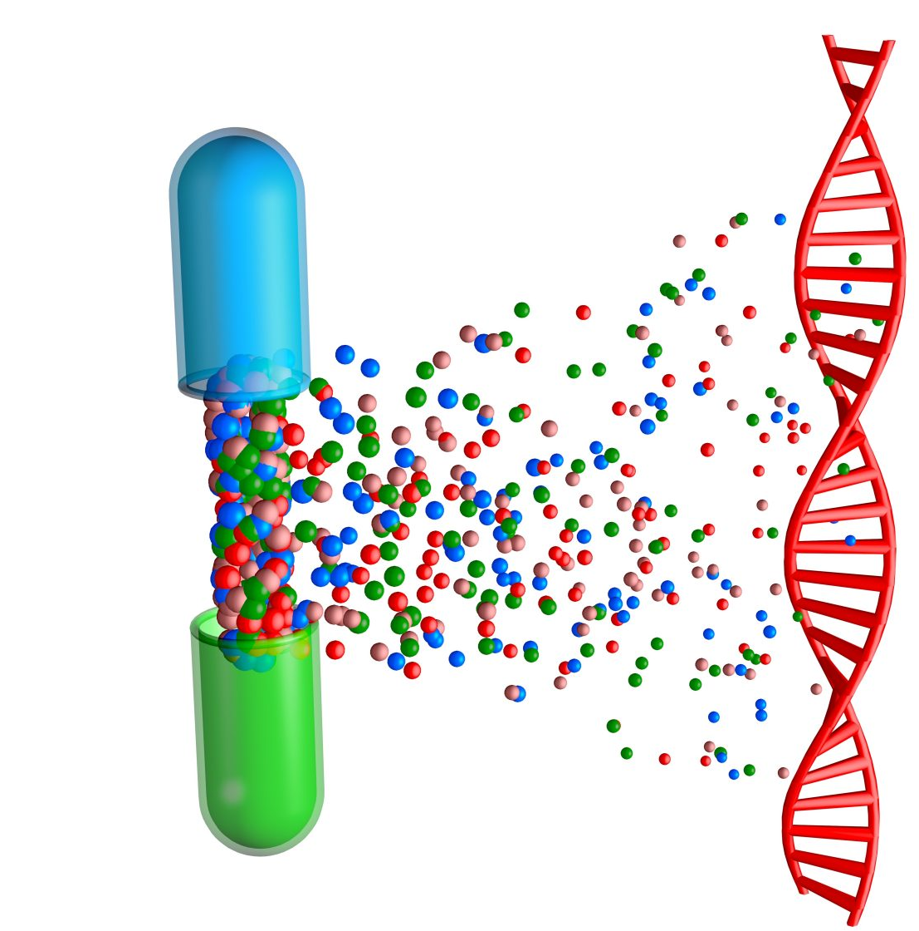
Pharmacogenomic Testing
Genetic tests that look at genes that metabolize (break down) medications
Medications ACTIVE --> LESS ACTIVE
POOR metabolizers will not break down medications as well as normal metabolizers
  Increased risk for side effects
RAPID metabolizers will break down medications more quickly than normal metabolizers
  Potential for less efficacy
Implications with ADHD and anxiety medications
Recommended when have not done well with several medications and additional medication needs are likely
Testing can be done with cheek swab or blood test

Slide 36
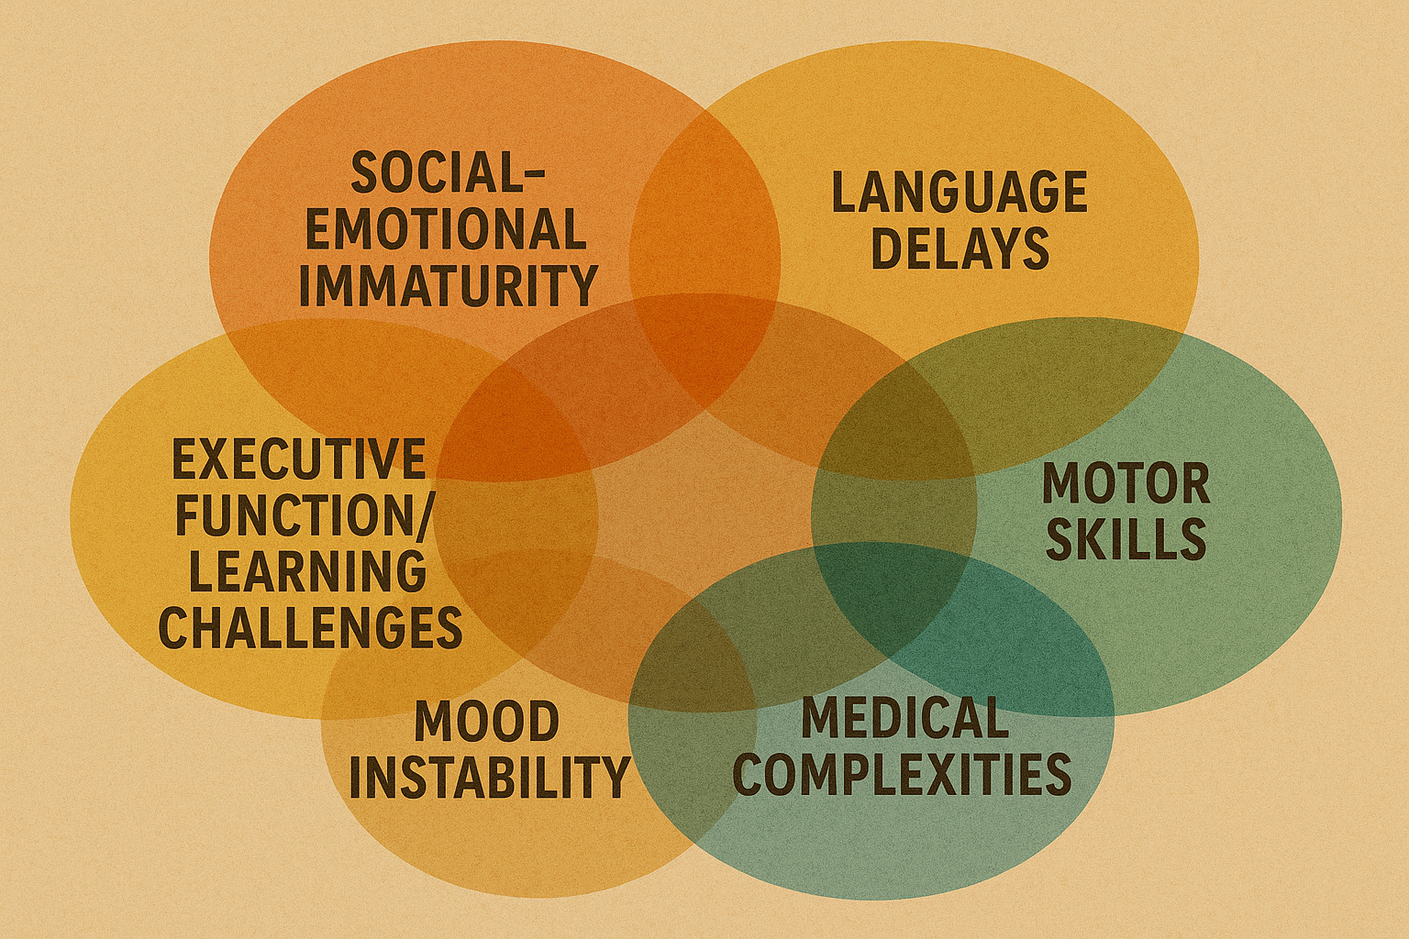
Summary
Anxiety & ADHD impact teens & young adults with XY variations at higher rates
Presentation is more complex than "typical" anxiety/ADHD presentations
Many available treatment options!

Slide 37






Colorado Team
Nicole Tartaglia, MD, MS
Susan Howell, MS, CGC
Shanlee Davis, MD, PhD
Rebecca Wilson, PsyD
Jennifer Janusz, PsyD
Talia Thompson, PhD
Samantha Bothwell, MS
Caitlin Middleton, PhD
Megan Louderman, PsyD
Syd Martin, MS OTR
Jackie Frazier, MS, CCC-SLP
Michelle Martinez-Chadrom, MS, CCC-SLP
Kayla Nocon, MS
Lidia Grzybacz, BS
Kayla Molison, MS
Alexa Carl, MPH
Andrew Keene, BS
Mia Middleton, BS
Natalia Klamut, BS
Aleks Radunivik, BS
Emma Todd, BS
ACKNOWLEDGEMENTS
eXtraordinarY Babies Study Collaborators:
Judith Ross, MD - Nemours Children’s Hospital
Karen Kowal, NP
Charuta Ikomi, MD
Nemours Research Team
Najiba Lahlou, MD, PhD
Research Participants, Families and Students!
Past:
Richard Boada, PhD
Tanea Tanda, BA
Lisa Cordeiro, MS
Mariah Brown, BS
Caroline Harrison, MPH
Amira Herstig, MS
Laura Pyle, PhD
Adrienne Villagomez, PhD
Stephanie Takamatsu, PsyD
Jillian Kirk, MS
Christina Miller, MS
Carly Peterson, MS, CGC
Stephanie Contreras, BS
Funding and Support:

