Slide 1





Beyond XXY: Exploring Gender Identity in Klinefelter Syndrome
Professor Tet Yap
Professor of Urology Kings College London & Guys & St Thomas Hospital, London
Lead, THE KLINEFELTER MULTIDISCIPLINARY CLINICS, UK
Dr Alice Cotton
Chief Nurse Researcher, THE KLINEFELTER MULTIDISCIPLINARY CLINICS, UK

Slide 2
Conflict of Interest Disclosure
No conflicts of interest
GUYS ANDROLOGY DEPARTMENT &
GUYS ANDROLOGY RESEARCH UNIT (GARU)

Slide 3

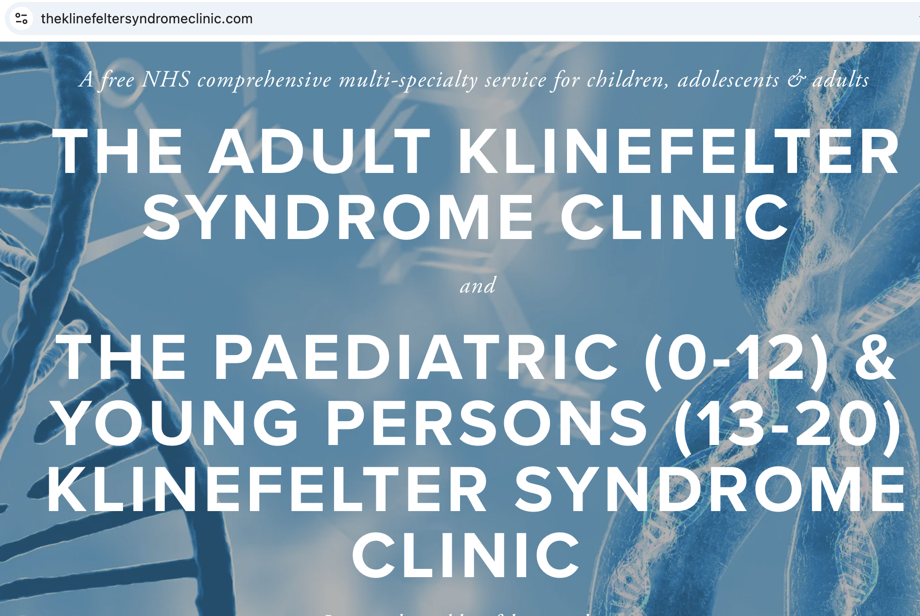
The UK Klinefelter Syndrome Clinic
Notes:
The Klinefelter Syndrome Multi-Specialty free NHS clinics are one of the first in the country to address the needs of patients diagnosed with Klinefelter (XXY) Syndrome. Klinefelter Syndrome affects 1:660 men and is thought to be one of the commonest congenital chromosomal disorders.
We run three types of free clinics:
one for adults (The Adult Klinefelter Syndrome Clinic)
one for children aged 0-12 (The Paediatric Klinefelter Syndrome )
one for young people aged 13-20 (The Klinefelter Syndrome for Young People)
Each clinic runs four times a year except the paediatric clinic which currently runs once a year,with plans to increase its frequency soon

Slide 4

One-stop clinic
Specialists in:
Genetics
Endocrinology
Urology
Reproductive medicine
Psychosexual medicine
Radiology
Adolescent psychology
Neuro-disability
Individualized care plan
Support from the Klinefelter Syndrome Association (UK charity)
Notes:
This is a one-stop clinic that covers all important aspects of the disease, with specialists in genetics, endocrinology, urology, reproductive medicine, psychosexual medicine and radiology all seeing and counselling patients through the various aspects of the condition.
For the young persons clinic, our expert team includes paediatric specialists in the same fields as the adult team, along with dedicated adolescent psychology input encompassing clinical and educational psychology as well as in some cases, neurodisability. A nurse counsellor is present to address any other personal concerns a patient may have. An individualised management plan is then created for each patient based on his priorities and this is given to both patient and GP/referring clinician.
Having a one-stop clinic visit reduces the number of visits a patient may have to make and also effectively ensures that all the key issues in the disease can be covered an address by a dedicated team in a specialist setting. In addition, a member of the Klinefelter Syndrome Association (see link below) may be present who may be able to give a personal view on living with Klinefelter Syndrome.

Slide 5
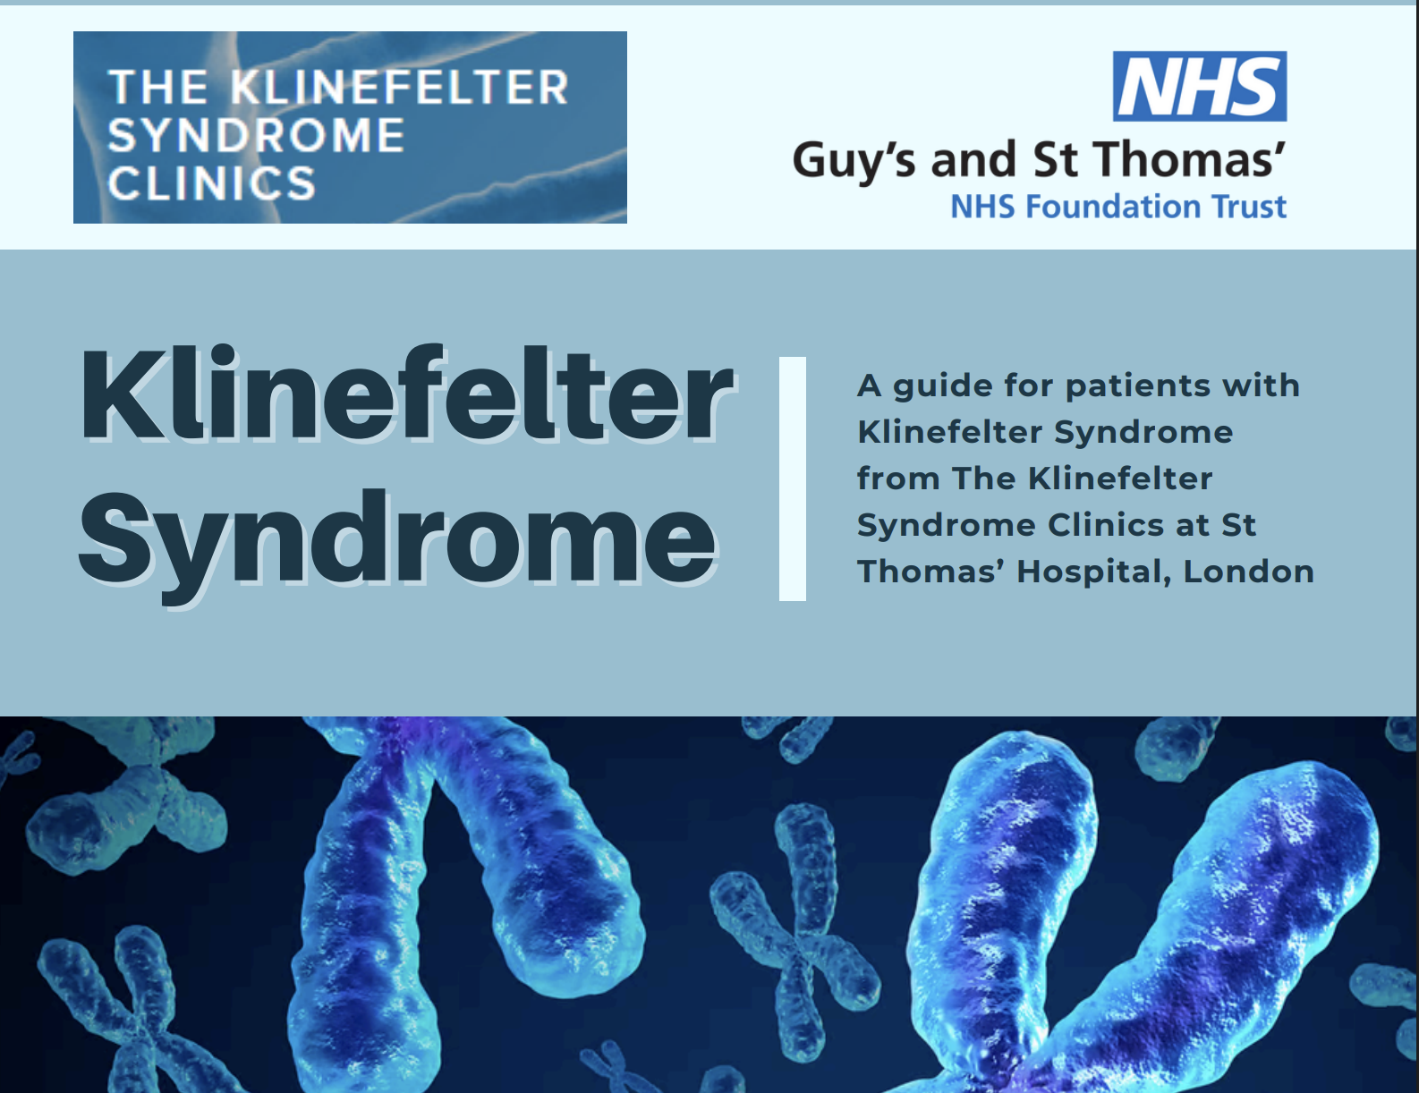
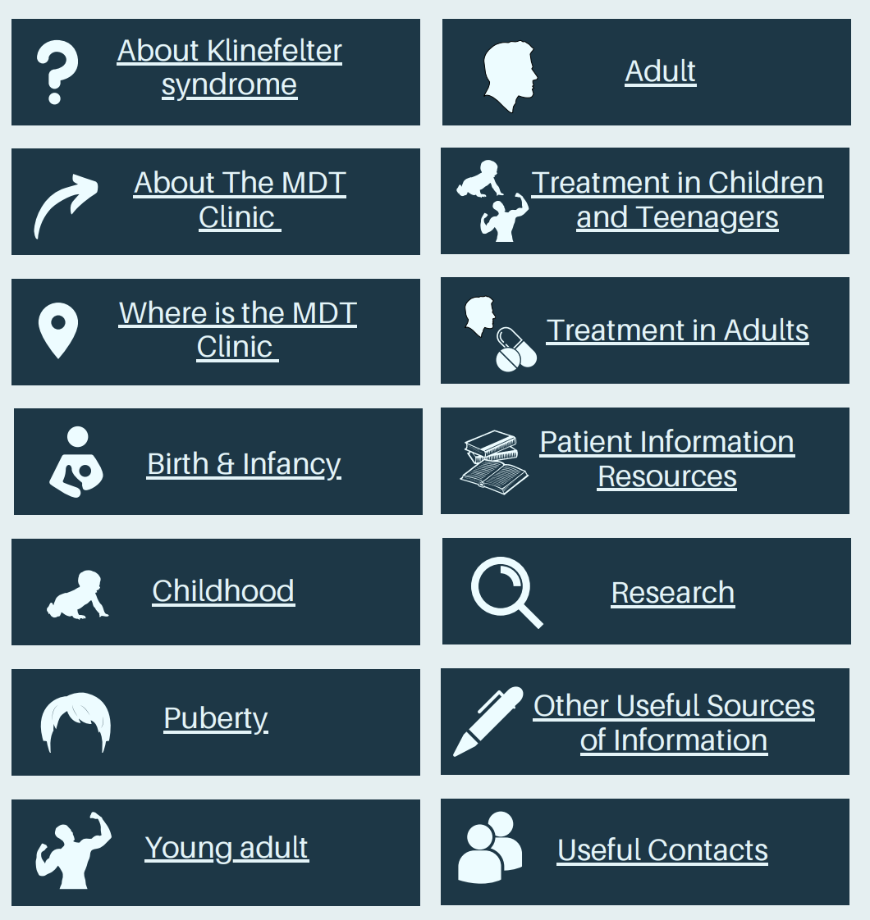
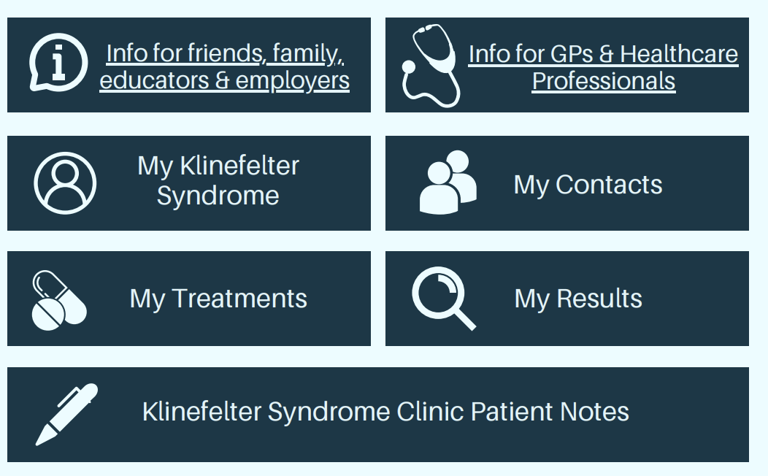
The Klinefelter Syndrome Clinic Passport
Notes:
The Klinefelter Syndrome Multidisciplinary Clinic Patient Passport: This is a comprehensive guide for people with Klinefelter Syndrome (KS) from The Klinefelter Syndrome MDT Clinics at St Thomas’ Hospital, London. It has been developed with patients, doctors and allied health professionals dedicated to the care of patients with Klinefelter syndrome and includes resources to share with GPs and employers. This guide can be used by patients and healthcare professionals. The first version of the passport has been uploaded in December 2024 with 6 monthly reviews and updates of content or whenever important KS findings are announced.

Slide 6

Data from the clinic
Natural history of KS
Effects of testosterone therapy
Fertility outcomes
Risk of other conditions, e.g. blood clots, diabetes, cancers
Cells and tissues
Detecting diseases and conditions
Better treatments
Notes:
Registry - long term data on the natural history of the disease is still lacking, especially with regards to risk of thromboembolism, effects of Testosterone therapy, fertility outcomes and risk of osteoporosis ,diabetes and cancers – all issues linked to Klinefelter patient care. We have secured funding from the Klinefelter Association (KSA) to develop a secure database for our patients seen in the KS MDT clinic in order to help monitor long term patient reported outcomes.
Biobank. Cells and tissues are examined by a pathologist to help make a diagnosis. Once tissue has been selected for this, any remaining cells or tissue that the pathologist doesn't need can either be kept for research (with your permission) or be disposed of. The surplus cells and tissue for research are collected in a research biobank. Human cells and tissue are vital for medical research. Scientists use them to: learn how diseases start and progress identify cell characteristics to be even more certain that a particular treatment will be effective observe effects of new drugs and tests before clinical trials begin with volunteer patients. Research may lead to new tests, better treatments for diseases such as cancer and ways of detecting diseases earlier. I

Slide 7
What is GENDER IDENTITY ?
Gender identity: a person’s deeply felt sense of being male, female, both, in between, or something other
Gender questioning: the process whereby an individual comes to question the usefulness or validity of their current biological sex and/or assigned gender
Notes:
Gender identity refers to a person's internal sense of their own gender, which may or may not align with the sex they were assigned at birth. While most individuals with Klinefelter syndrome are born male and identify as such, some may experience gender dysphoria and identify as female or non-binary.
Gender identity is all about how you think about yourself. It’s about how you internally interpret the chemistry that composes you (e.g., hormone levels). As you know it, do you think you ft better into the societal role of “woman” or “man,” or does neither ring particularly true for you? Tat is, do you have aspects of your identity that align with elements from both? Or do you consider your gender to fall outside of the gender norms completely? Te answer is your gender identity. It has been accepted that we form our gender identities around the age of three and that afer that age, it is incredibly difficult to change them. Formation of identity is affected by hormones and environment just as much as it is by biological sex. Ofentimes, problems arise when someone is assigned a gender based on their 3 Last Edited March 27, 2015 sex at birth that doesn’t align with how they come to identify.

Slide 8
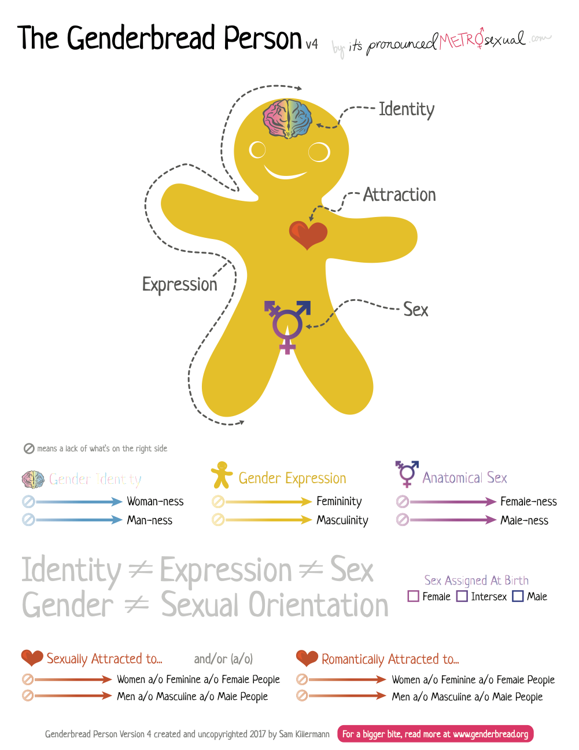
Notes:
Gender identity is all about how you think about yourself. It’s about how you internally interpret the chemistry that composes you (e.g., hormone levels). As you know it, do you think you ft better into the societal role of “woman” or “man,” or does neither ring particularly true for you? Tat is, do you have aspects of your identity that align with elements from both? Or do you consider your gender to fall outside of the gender norms completely? Te answer is your gender identity. It has been accepted that we form our gender identities around the age of three and that afer that age, it is incredibly difficult to change them. Formation of identity is affected by hormones and environment just as much as it is by biological sex. Ofentimes, problems arise when someone is assigned a gender based on their 3 Last Edited March 27, 2015 sex at birth that doesn’t align with how they come to identify.

Slide 9
Gender identity in KS: what do we know?
Klinefelter syndrome (47,XXY) is typically assigned male at birth, but lived gender experience can be diverse
Around half of individuals with KS identify fully as male
In utero exposure to less androgens. Delayed/poor development of secondary sexual characteristics especially at puberty (gynaecomastia, sparse body hair) may influence gender experience
Psychological impact of having an extra ‘female’ chromosome
Emerging evidence suggests there may be higher rates of gender questioning in KS compared with the general male population
Notes:
KS are thought of as genotypically male due to the presence of their Y chromosome and testes development.
Patient-reported identity
Around half of individuals with KS identify fully as male
A substantial minority identify as:
Female
Non-binary or intersex
Undecided or fluid over time
BUT
Delayed/poor development of secondary sexual characteristics especially at puberty (gynaecomastia, sparse body hair)
Psychological impact of having an extra ‘female’ chromosome
In utero exposure to less androgens
Not all KS individuals enjoy living as the sex assigned at birth
This does not always equate to gender dysphoria, but reflects a spectrum of experience
We are not saying gender diversity is universal in KS — but it is sufficiently prevalent that it should be routinely considered in clinical care.

Slide 10
Why this matters
Body image
Mental health
Decisions about hormone therapy
Testosterone may exacerbate gender incongruence for some
A minority prefer or seek estrogen instead
Support people more holistically, with screening and support for gender dysphoria right from diagnosis
Notes:
Why this matters. Gender identity intersects directly with:
Body image. Many report a disconnect between:
Physical characteristics
Internal sense of gender
Mental health - Transgender individuals have been shown to have greater rates of anxiety (Millet 2016), depression (Witcomb 2018) and suicidality (Maguen 2010). KS patients themselves have an increased prevalence of mental health issues (Bojesen 2006).
Decisions about hormone therapy. Hormone therapy
Testosterone replacement therapy (TRT) is standard for hypogonadism
However:
Not all patients on TRT identify as male
TRT may exacerbate gender questioning for some
A minority prefer or seek estrogen instead
Increasing research into the potential genetic basis of GD → variations in oestrogen receptor, oestrogen receptor coactivators & androgen receptor have been reported in trans individuals
About 1% of trans individuals also have KS (Liang 2022)

Slide 11

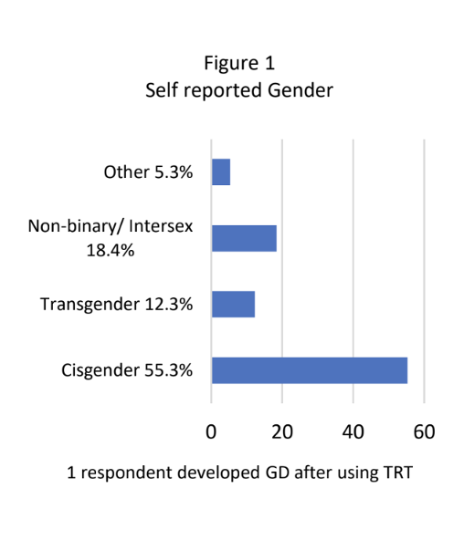
N = 114
Only 55% of respondents identified fully with the male gender
90% are registered as male on their birth certificate
19% (22/114) reported that they did not enjoy living as the sex on their birth certificate
Mean average participant age was 55
Majority Caucasian
Notes:
23-point questionnaire of KS patient attitudes to gender identity developed by KS patients & health professionals
Questionnaire was developed by multiple clinicians (including gender psychiatrists, urologists, psychosexual medicine specialists and endocrinologists) and patient Delphi rounds, in collaboration with members of the UK Klinefelter Syndrome Association (KSA)
Disseminated to patients from the KSA & national – access KS MDT Clinics (2022-23)

Slide 12
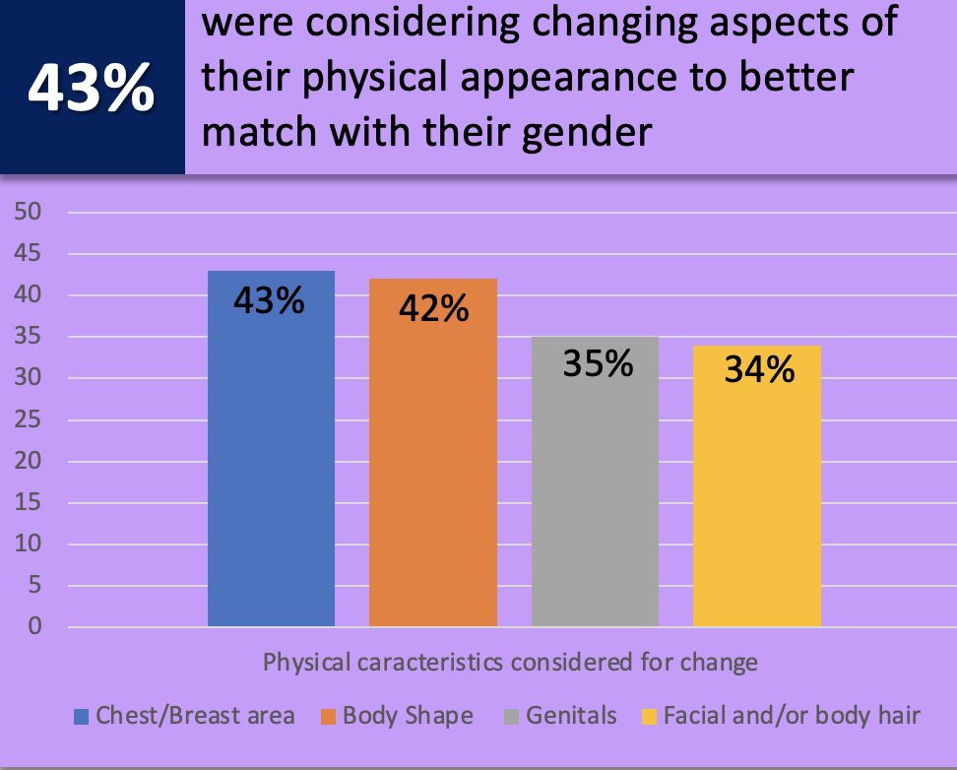

RESEARCH
55% felt that some of their physical characteristics did not match their gender

Slide 13

5% of KS individuals shared experiences of being let down by the medical system, feeling mocked by clinicians because of their gender identity or that clinician understanding of KS was lacking
Participants reported frustration with
lack of knowledge of KS amongst healthcare professionals
instances of being denied access to gender-related services on account of their KS diagnosis

Slide 14
THE FUTURE
Better understanding about gender identity, questioning and dysphoria people with KS
Need to establish clear standards of care for gender support → difficult as KS itself undiagnosed in 70%
Assessment tools to identify gender dysphoria
Educational resources to support patients, families and clinicians
Better services and referral pathways to support gender dysphoria in KS
The role of testosterone therapy
Clinicians should explore and address gender identity concerns amongst KS patients, to ensure that individualized treatment plan can be offered that suit their specific needs
Notes:
Participants in a control group who did not have KS were
not used.
• The sample group was small and there was a lack of
diversity, so a wider perspective of gender identity issues
and the preference of hormone therapy in other
demographics was not obtained.

